Slide 1
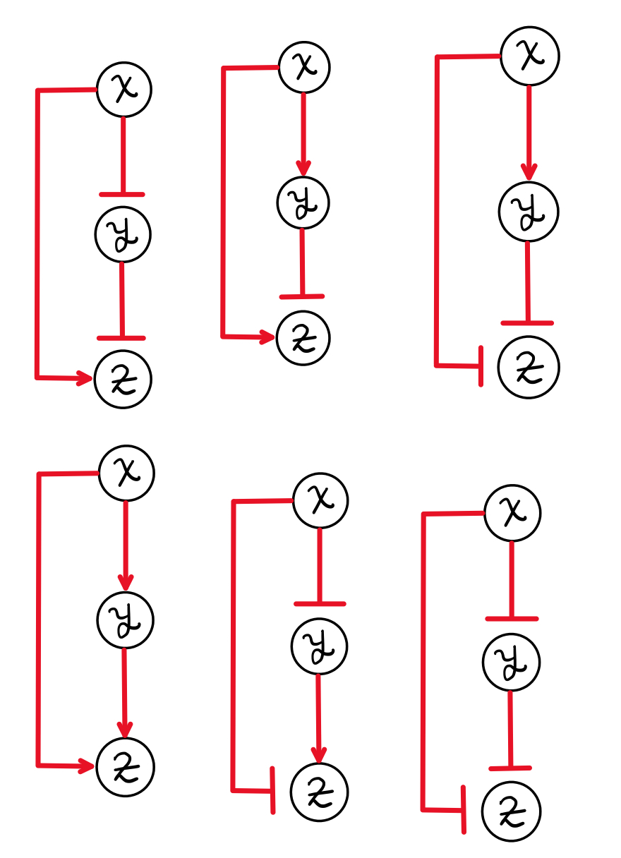
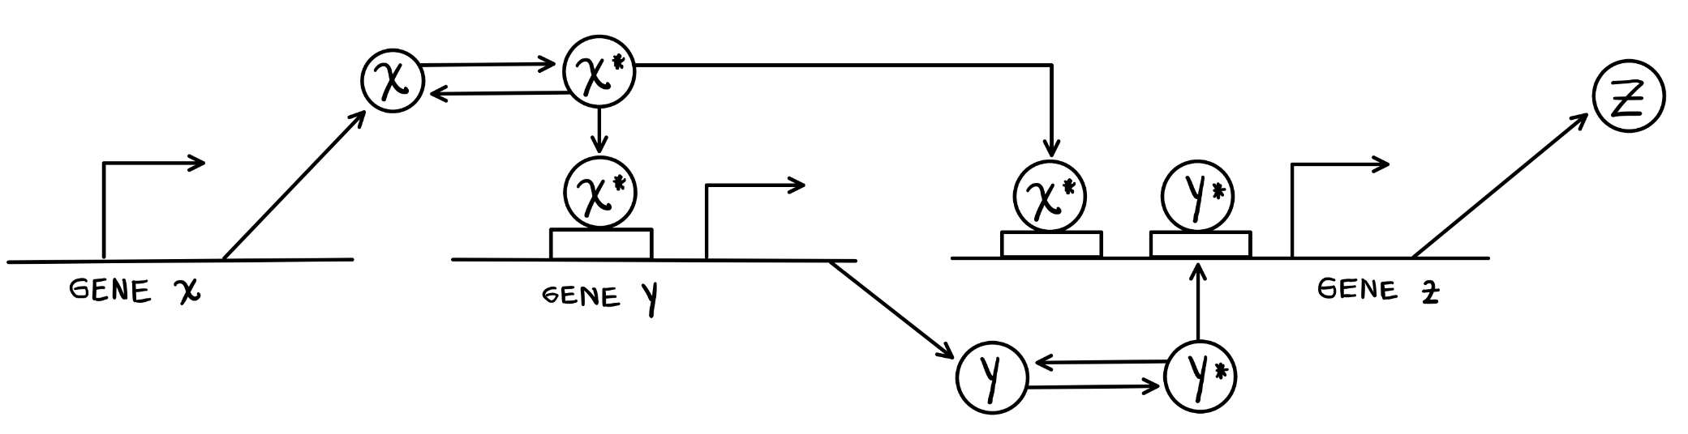

Health, mortality and Human Aging
Rafael Enrique Velásquez Rojas

Slide 2
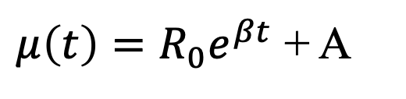
Gompertz Law to model the exponential increment
$μ\left(t\right)=R_{0}e^{βt}$ + A
Exponential model to explain the exponential increment of mortality with age
Sum of age dependent term and age independent term
Slide 3
Notes:
Some population there are described by high age independent death rates

Slide 3
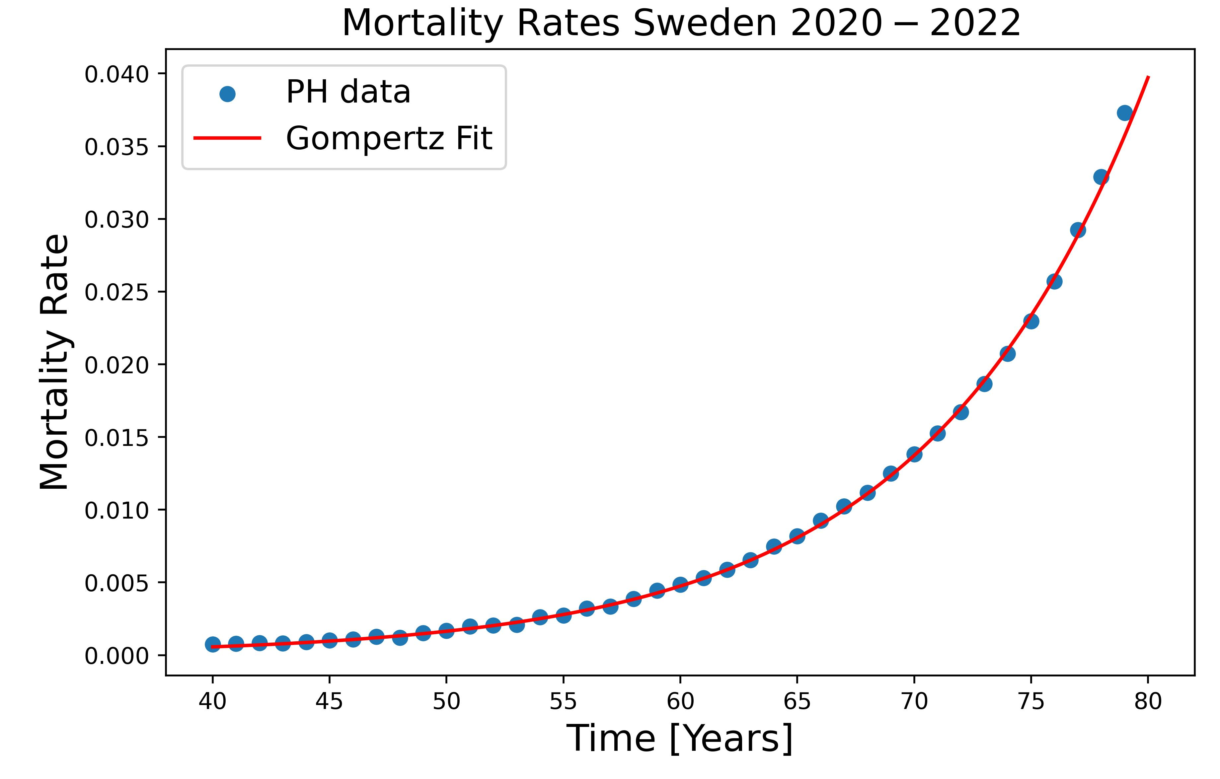
Gompertz Law to model the exponential increment
$μ\left(t\right)=R_{0}e^{βt}$ + A
Exponential model to explain the exponential increment of mortality with age
Sum of age dependent term and age independent term
Slide 3
Notes:
Some population there are described by high age independent death rates

Slide 4
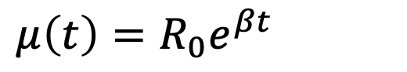
Gompertz Law to model the exponential increment
$μ\left(t\right)=R_{0}e^{βt}$
Gompertz Law exponential mortality
Slide 4
Notes:
Some population there are described by high age independent death rates

Slide 5
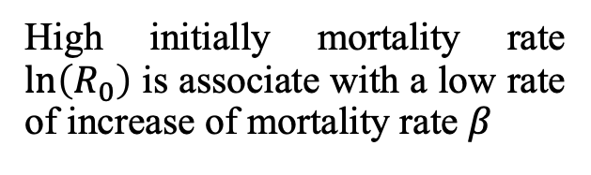
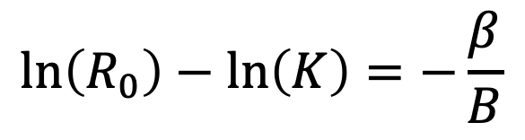
Strehler-Mildvan Correlation
$μ\left(t\right)=R_{0}e^{βt}$
Gompertz Law exponential mortality
$$\ln\left(R_{0}\right)−\ln\left(K\right)=−\frac{β}{B}$$
Correlation between two parameters of Gompertz Law
High initially mortality rate $\ln\left(R_{0}\right)$ is associate with a low rate of increase of mortality rate $β$
Slide 4
Notes:
Some population there are described by high age independent death rates

Slide 6
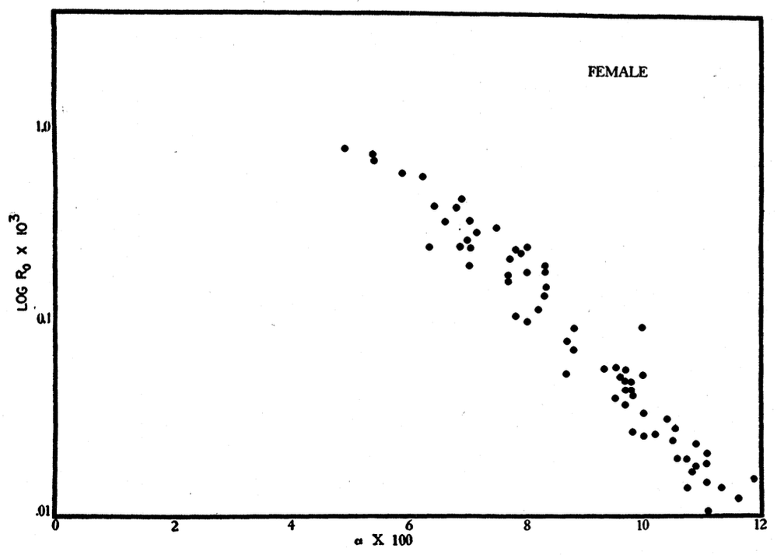
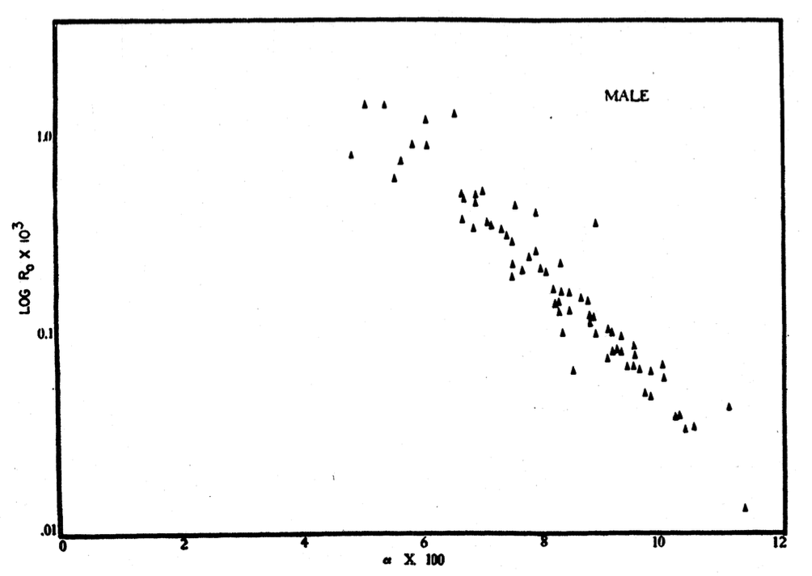
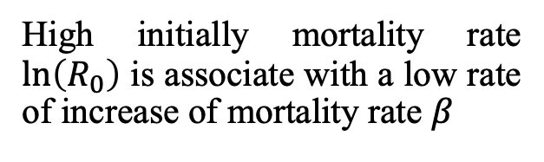
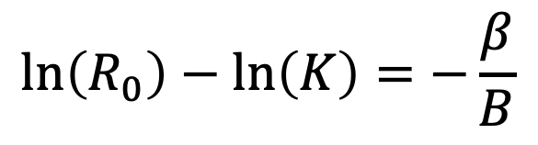
Strehler-Mildvan Correlation
$$\ln\left(R_{0}\right)−\ln\left(K\right)=−\frac{β}{B}$$
High initially mortality rate $\ln\left(R_{0}\right)$ is associate with a low rate of increase of mortality rate $β$
Slide 4
Notes:
Some population there are described by high age independent death rates

Slide 7
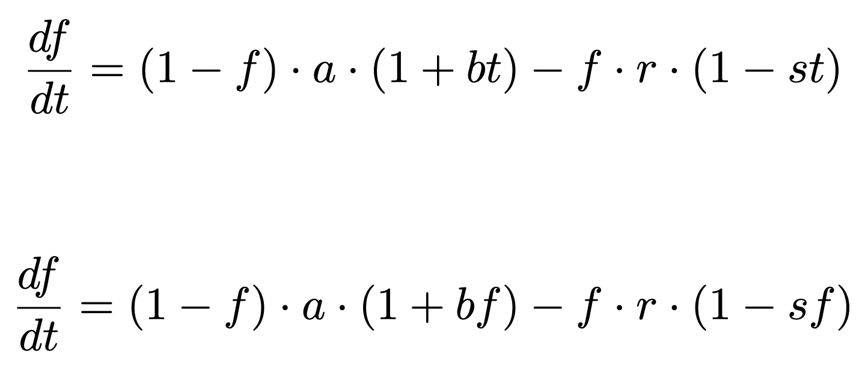
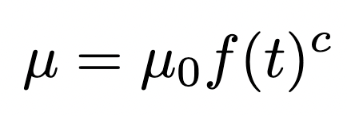
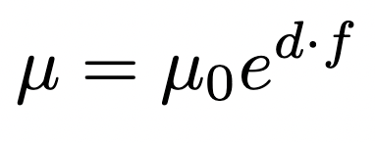
Developing a model for frailty index and mortality
Option 1 for frailty index model
Option 2 for frailty index model
Option 1 for mortality rate model
Option 2 for mortality rate model
Slide 8
Notes:
Some population there are described by high age independent death rates

Slide 8
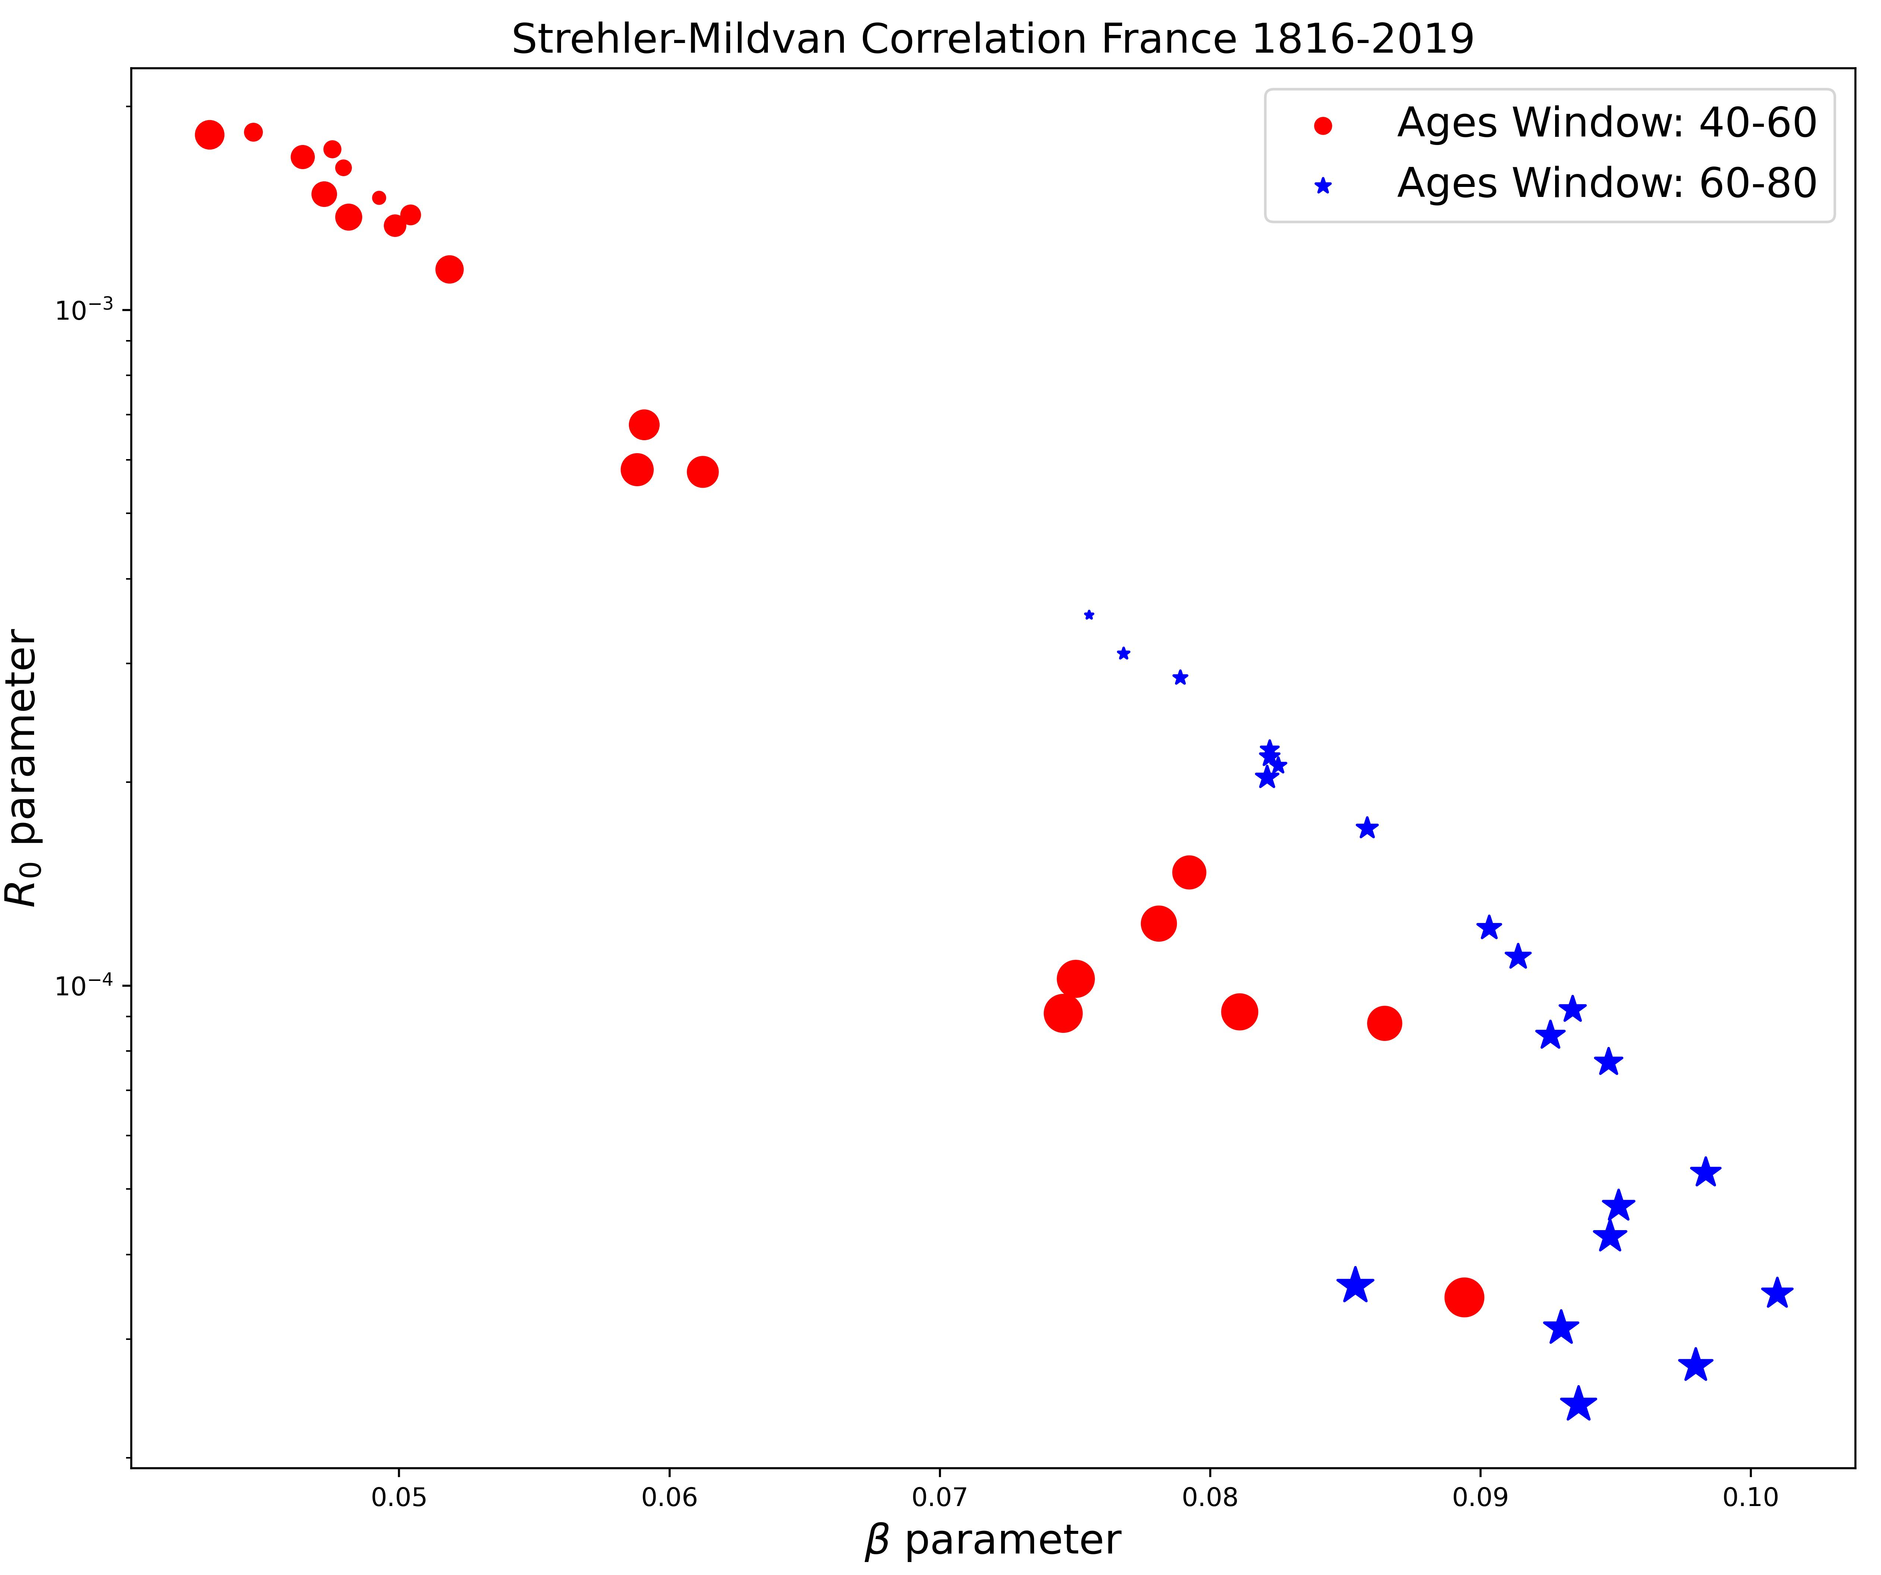
Strehler-Mildvan Correlation phenomenological data
Slide 9

Slide 9
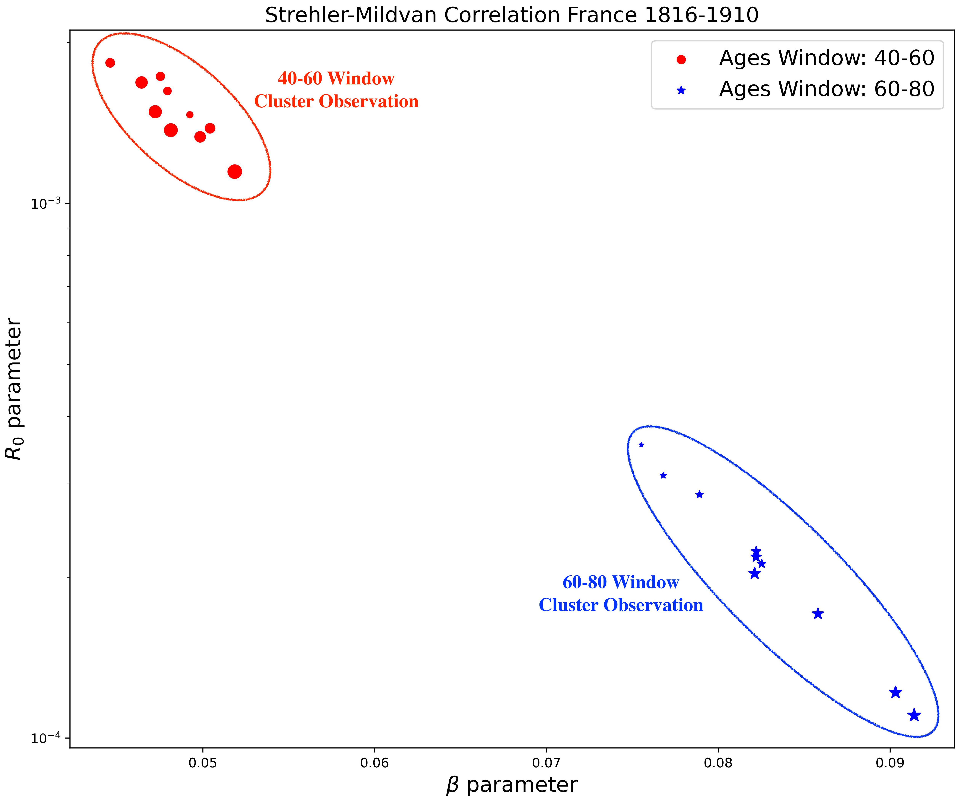
Strehler-Mildvan Correlation phenomenological data
Slide 9

Slide 10
Strehler-Mildvan Correlation phenomenological data
Slide 10

Slide 11
Strehler-Mildvan Correlation phenomenological data
Slide 10

Slide 12
Strehler-Mildvan Correlation phenomenological data
Differences in the correlation between the 40-60 window and the 60-80 window ages.
Slide 10

Slide 13
Strehler-Mildvan Correlation phenomenological data
Differences in the correlation between the 40-60 window and the 60-80 window ages.
Depending on the observation window, there are different values for the parameters of Gompertz’s Law.
Slide 10

Slide 14
Why these proposals for the models?
Slide XXX

Slide 15
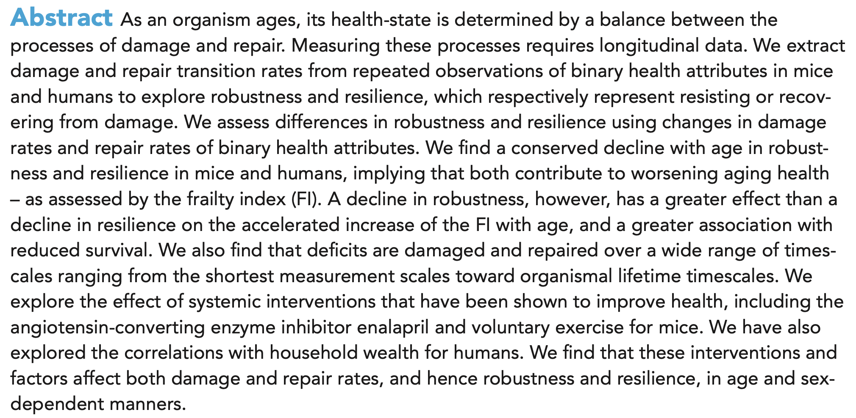
Why these proposals for the models?
Farrell, S., Kane, A. E., Bisset, E., Howlett, S. E., & Rutenberg, A. D. (2022). Measurements of damage and repair of binary health attributes in aging mice and humans reveal that robustness and resilience decrease with age, operate over broad timescales, and are affected differently by interventions. Elife, 11, e77632.
Slide XXX

Slide 16
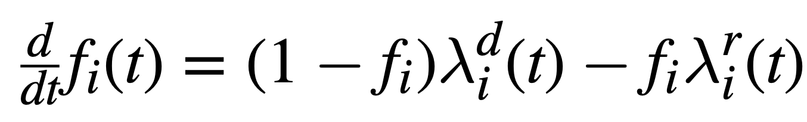
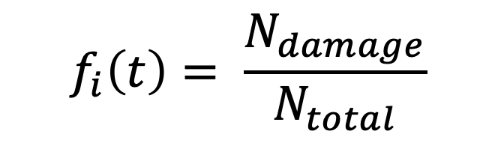


Repair and damages nodes model
$$f_{i}\left(t\right)= \frac{N_{damage}}{N_{total}}$$
$${(1−f}_{i})≝attributes available for damage$$
$$f_{i} ≝attributes available for repair$$
Slide XXX

Slide 17


Connection with our proposed model
Slide 8
Notes:
Some population there are described by high age independent death rates

Slide 18
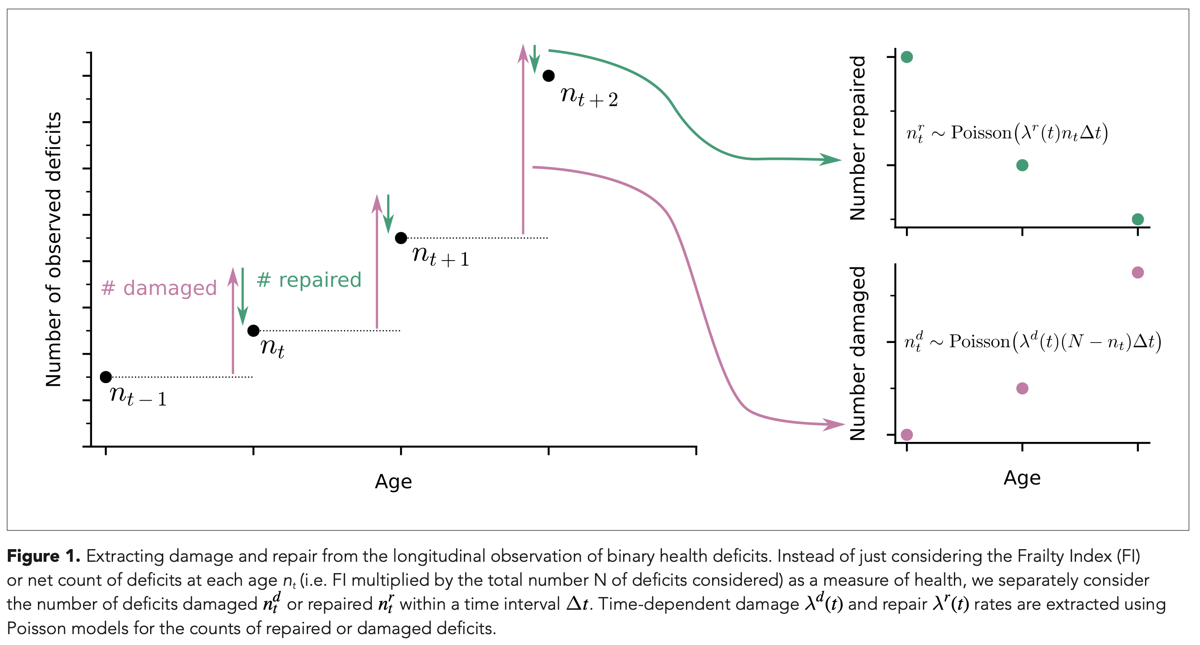
Number of Repaired and Damage Nodes
Slide XXX

Slide 19
Number of Repaired and Damage Nodes
This is the behavior of the repair and damage rates that we need to obtain the desired behavior for the model.
Slide XXX

Slide 20
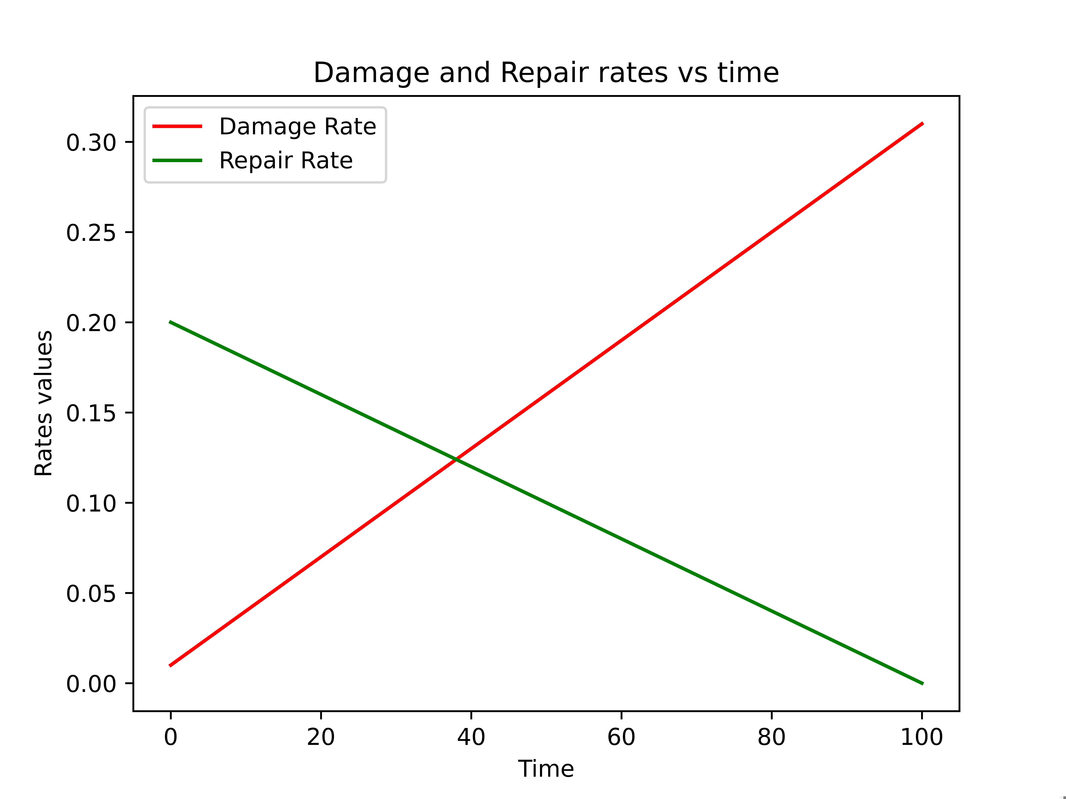
Number of Repaired and Damage Nodes
This is the behavior of the repair and damage rates that we need to obtain the desired behavior for the model.
Slide XXX

Slide 21
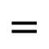
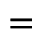
Number of Repaired and Damage Nodes
$$=$$
Damage rate function
$$=$$
Repair rate function
This is the behavior of the repair and damage rates that we need to obtain the desired behavior for the model.
Slide XXX

Slide 22
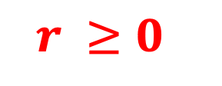
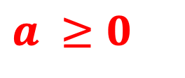
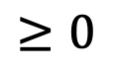
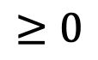
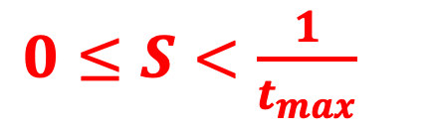
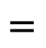
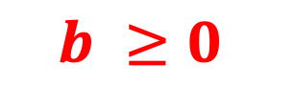
Guesses for the parameters
1) Both the repair and damage rate must be positive for all times.
$$=$$
$$≥0$$
$$=$$
$$≥0$$
$$a ≥0$$
$$b ≥0$$
$$r ≥0$$
$0≤S<\frac{1}{t_{max}}$
Slide XXX

Slide 23
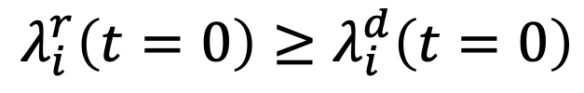
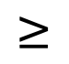
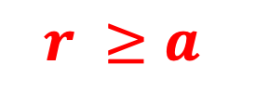
Guesses for the parameters
2) The rate of repair should be greater than the rate of damage at the onset of age.
At least a t = 0
Why?
$$λ_{i}^{r}\left(t=0\right)≥λ_{i}^{d}\left(t=0\right)$$
$$≥$$
$$r ≥a$$
Slide XXX

Slide 24
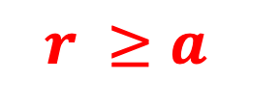
Guesses for the parameters
2) The rate of repair should be greater than the rate of damage at the onset of age.
At least a t = 0
Why?
$$r ≥a$$
Slide XXX

Slide 25
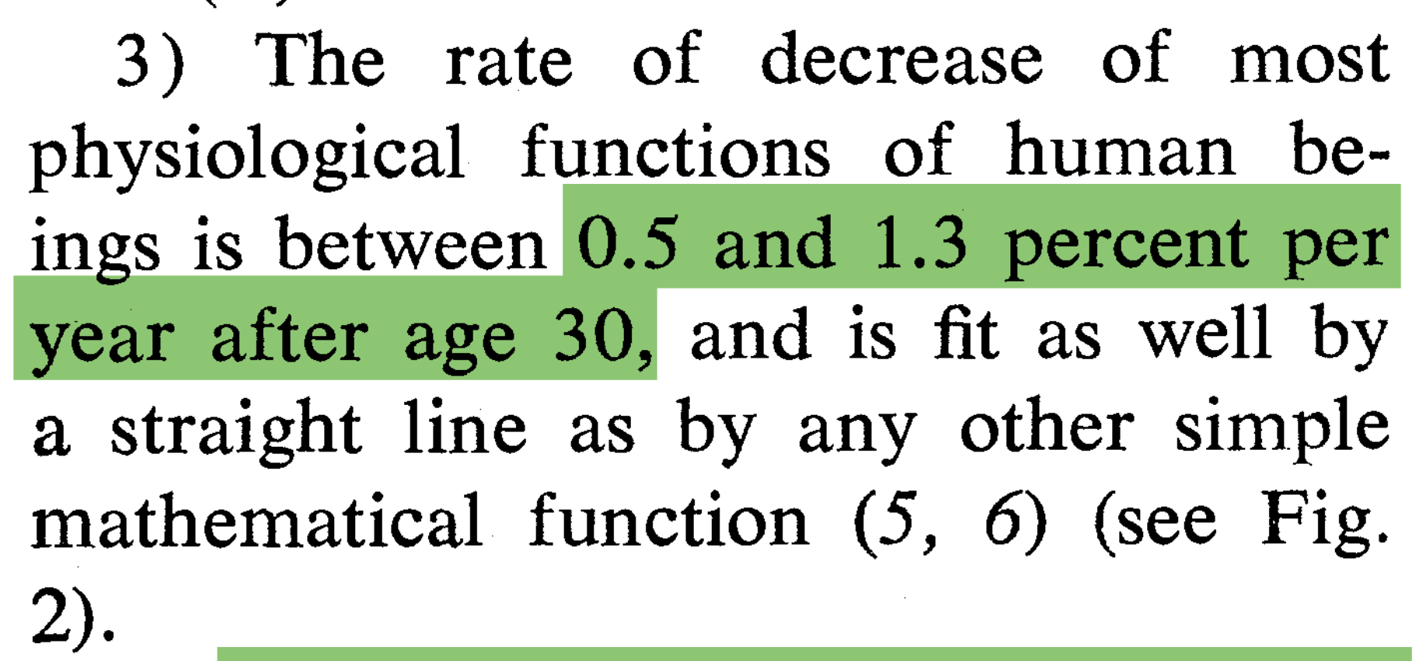
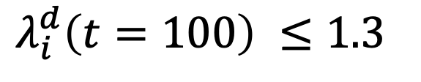
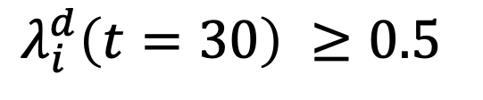
Guesses for the parameters
3) The rate of decrease of most physiological functions of humans beings is between 0.5 and 1.3 percent per year (???).
$$λ_{i}^{d}\left(t=30\right) ≥0.5$$
$$λ_{i}^{d}\left(t=100\right) ≤1.3$$
Slide XXX

Slide 26
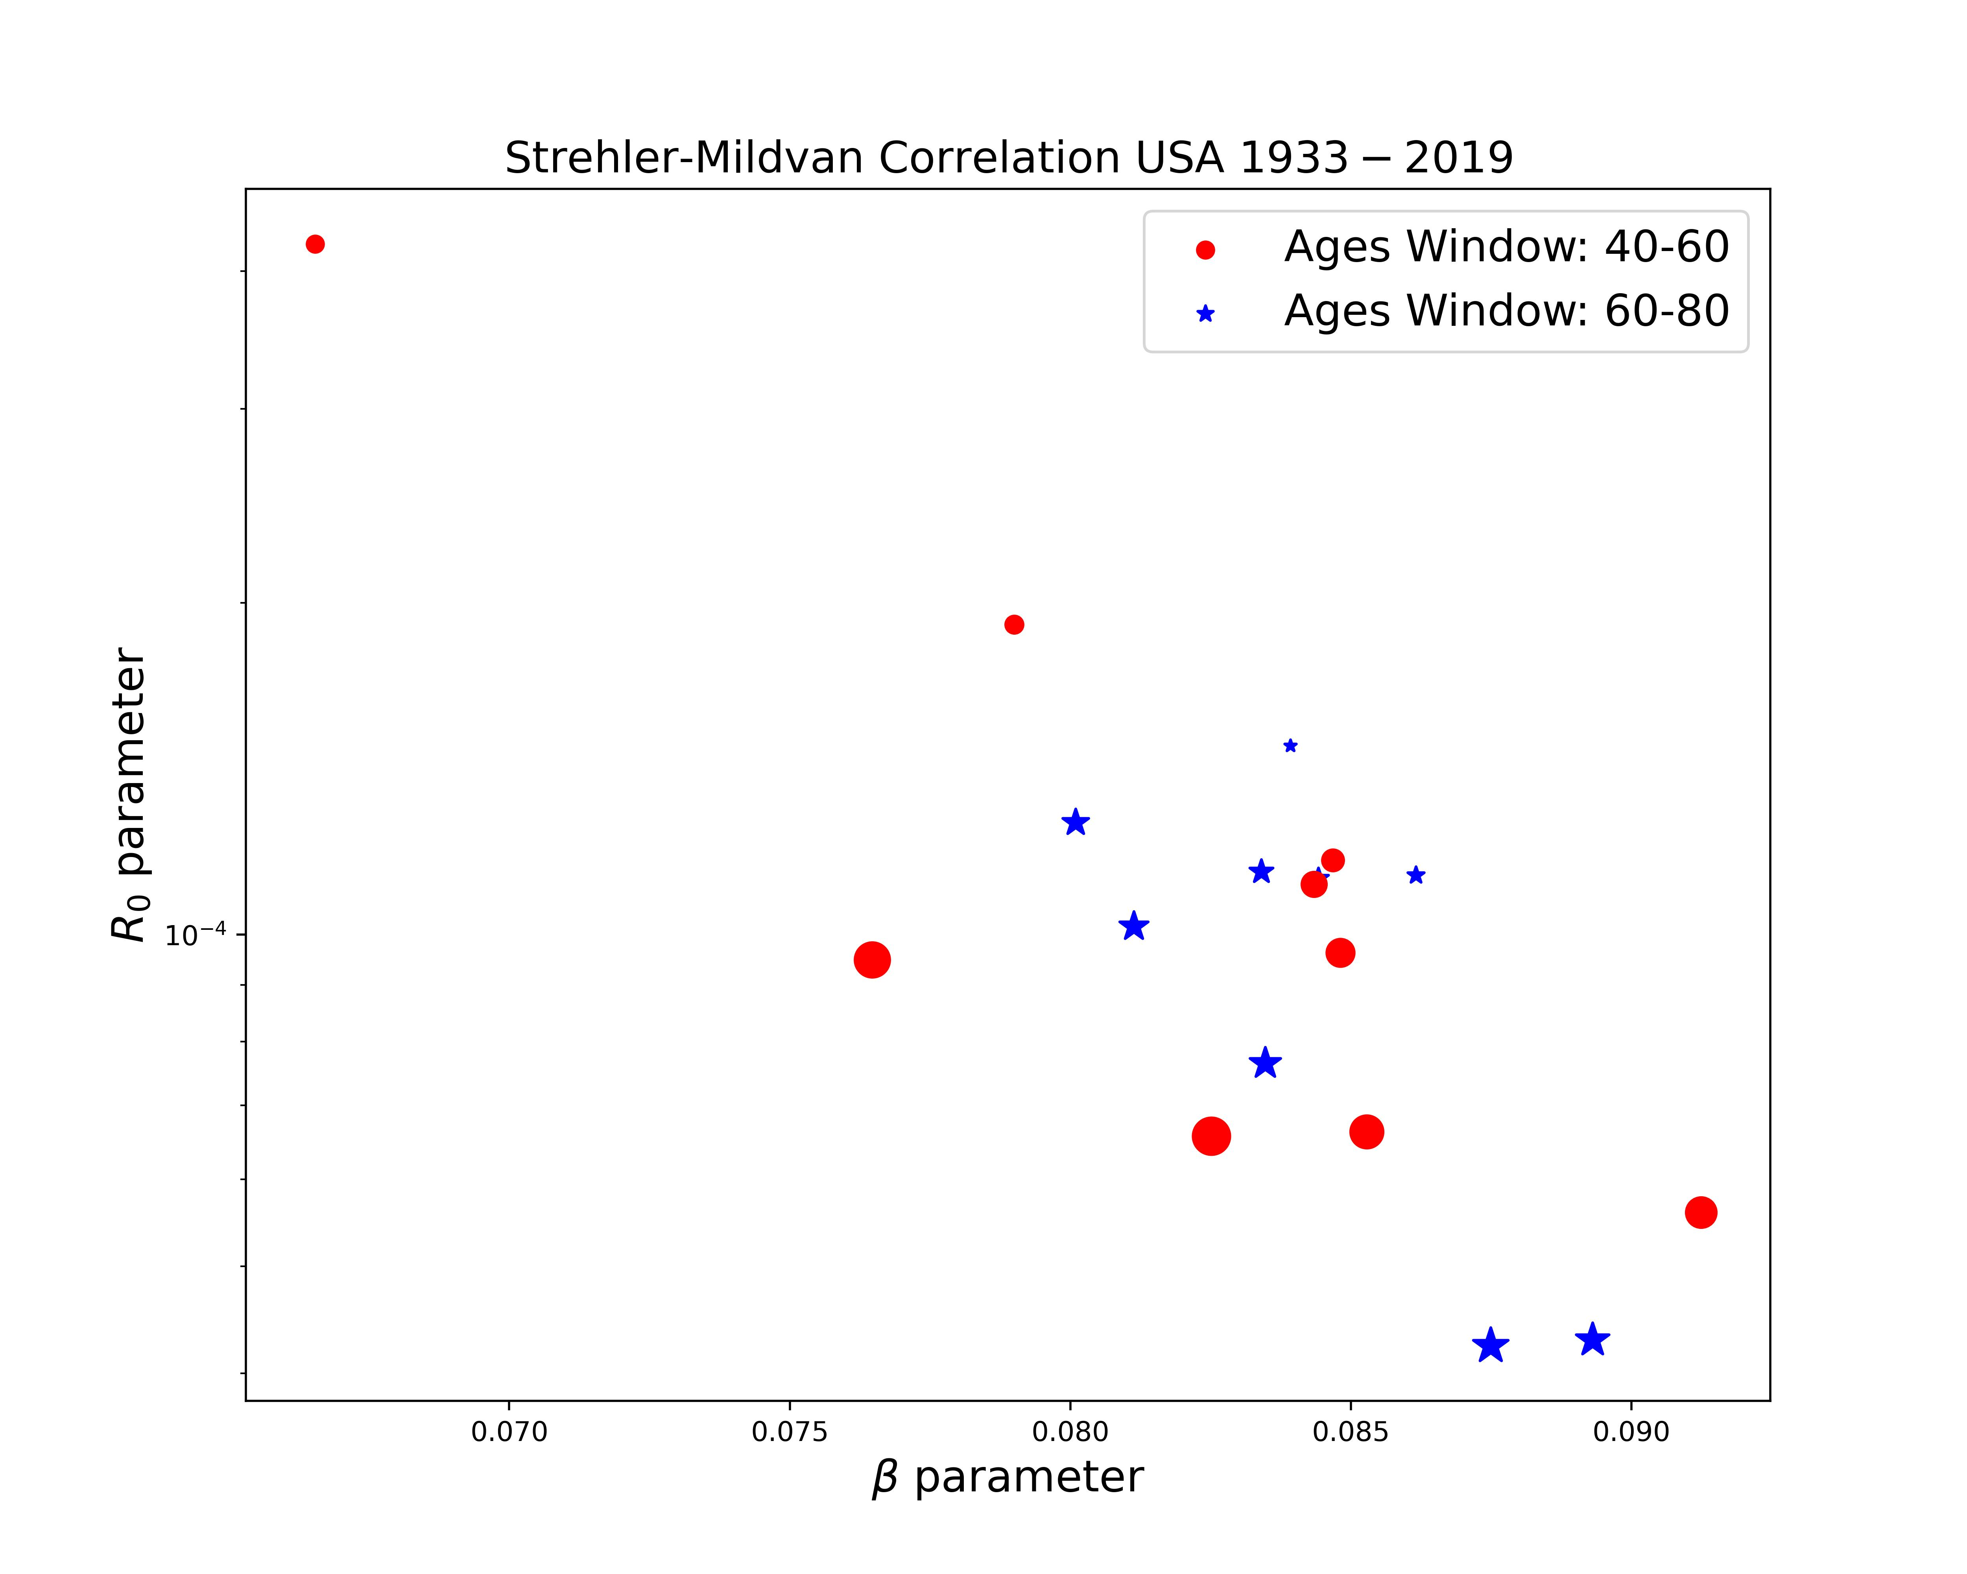

SM correlation is not a strong result

Slide 27
SM correlation is not a strong result
Here we will put results from phenomenological data that shows that Strehler-Mildvan Correlation is not a strong results.
The reason why we cant see the SM correlation as in the paper of 1960 is because:
Gompertz Slope (alpha) could change in the time
Ro could change in the time
Therefore, the correlation between this two values could be dynamic in time and not just one point for the entire curve of mortality rate.
Slide XXX

Slide 28
SM correlation is not a strong result

Slide 29
SM correlation is not a strong result

Slide 30
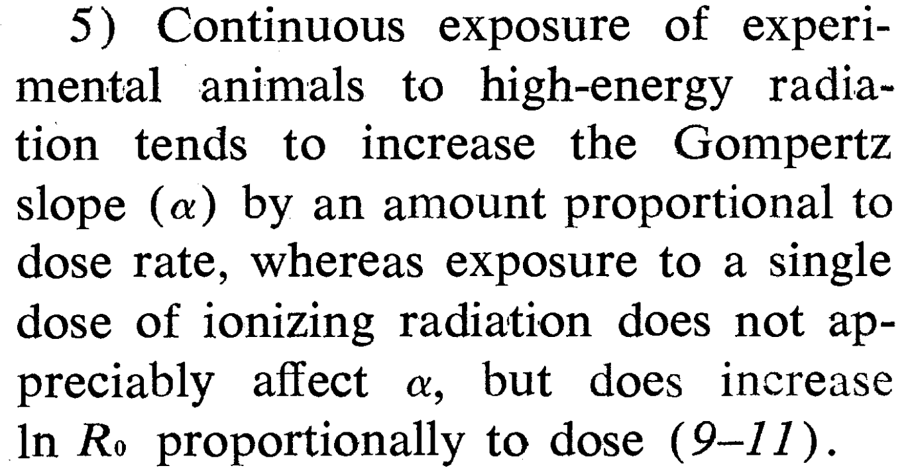


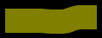
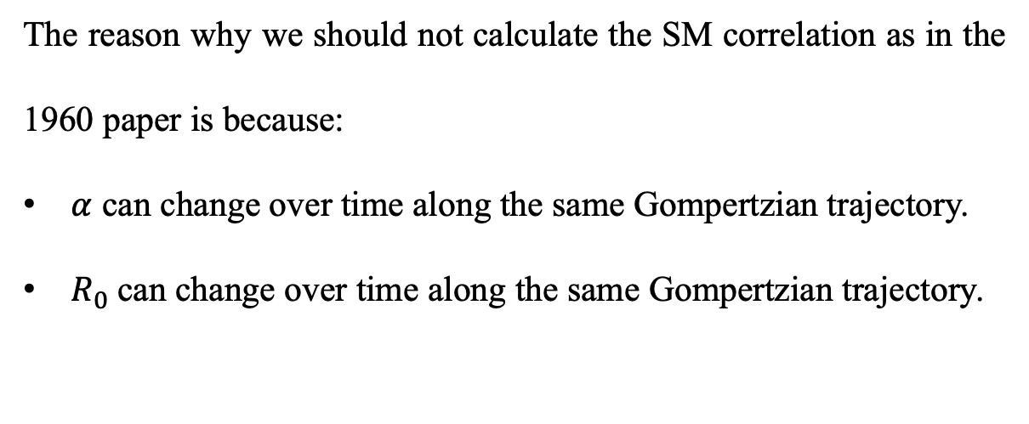
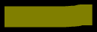

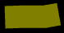
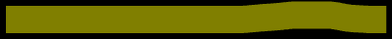
SM correlation is not a strong result (???)
The reason why we should not calculate the SM correlation as in the 1960 paper is because:
$α$ can change over time along the same Gompertzian trajectory.
$R_{0}$can change over time along the same Gompertzian trajectory.
Slide XXX

Slide 31
Model results for SM correlation
Slide XXX

Slide 32
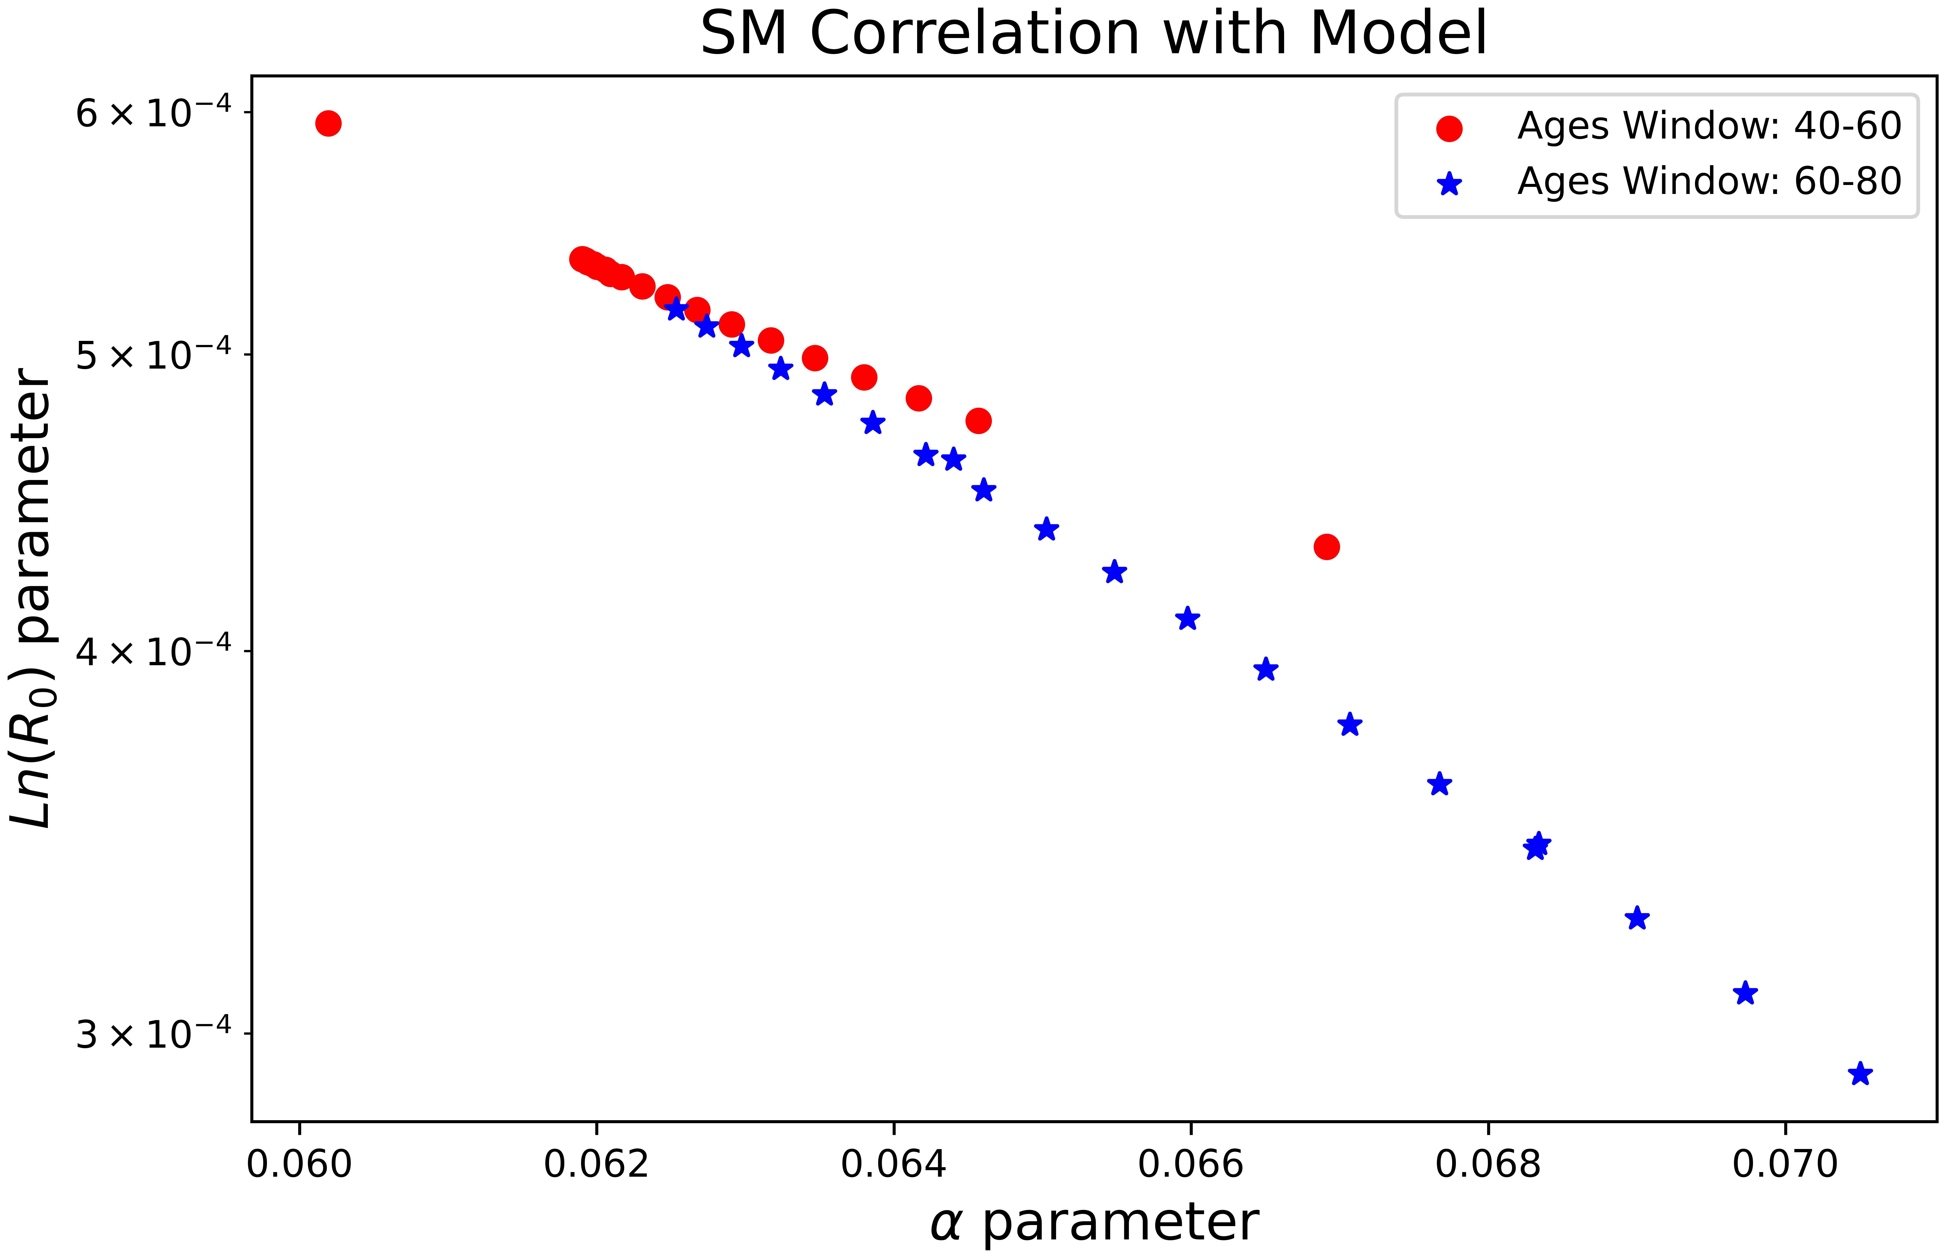
Model results for SM correlation
Slide XXX

Slide 33
Model results for SM correlation
Slide XXX

Slide 34
Model results for SM correlation
Slide XXX

Slide 35
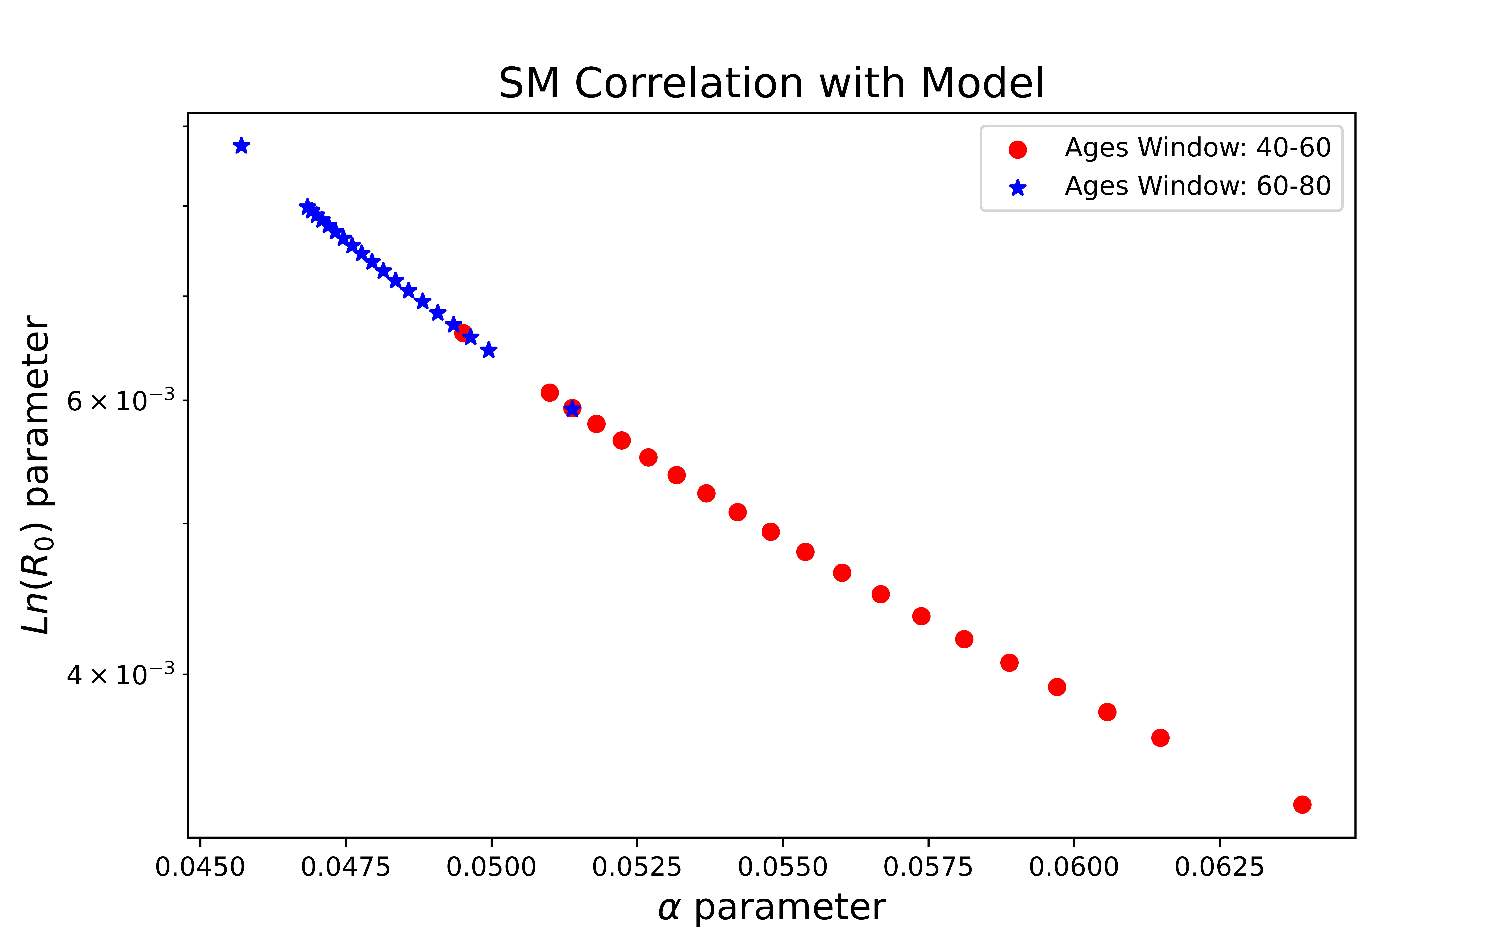
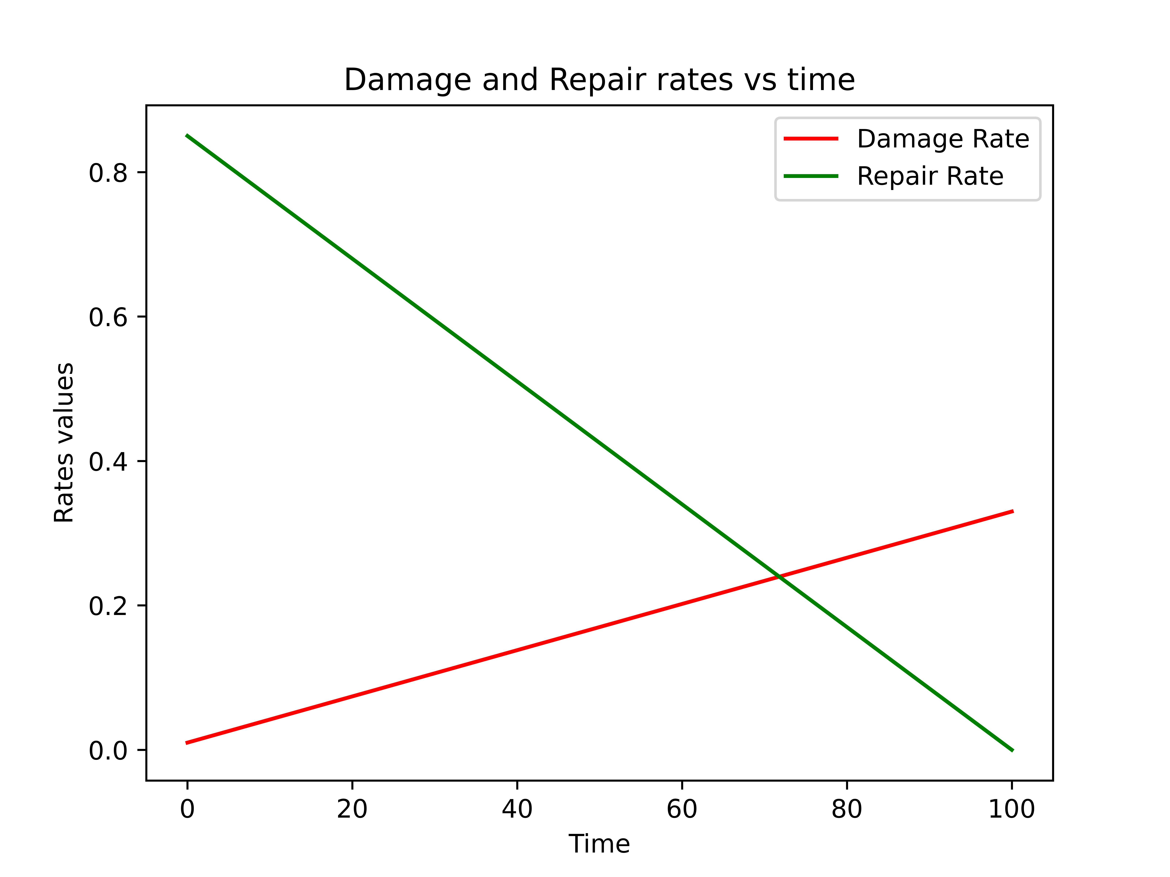
Model results for SM correlation
Slide XXX

Slide 36
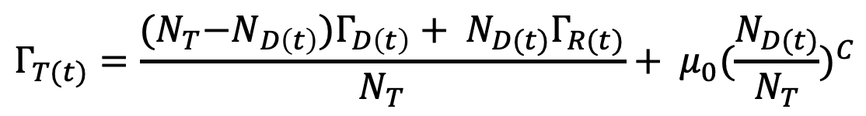
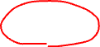
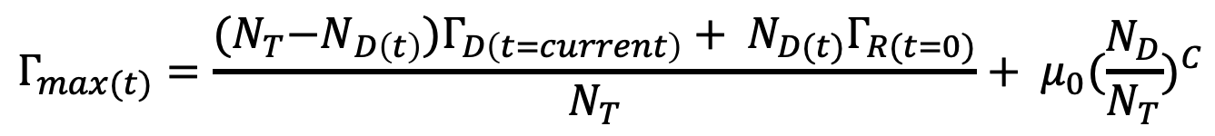
Stochastic Simulation
$$Γ_{T(t)}=\frac{{(N}_{T}−N_{D\left(t\right)})Γ_{D\left(t\right)}+ N_{D(t)}Γ_{R(t)}}{N_{T}}+ μ_{0}{(\frac{N_{D(t)}}{N_{T}})}^{C}$$
Current rate
$$Γ_{max(t)}=\frac{{(N}_{T}−N_{D\left(t\right)})Γ_{D\left(t=current\right)}+ N_{D(t)}Γ_{R(t=0)}}{N_{T}}+ μ_{0}{(\frac{N_{D}}{N_{T}})}^{C}$$
Maximum rate
Slide XXX

Slide 37






Stochastic Simulation
$$if random > \frac{Γ_{max(t)}−Γ_{T(t)}}{Γ_{max(t)}} ,$$
$$0>random>1$$
Decision State
Invariance in the behavior with $N_{T }$(???)
$$=$$
It is not the same a = 0.2 with $N_{T }=10$ as it is to $N_{T }=1.000$ (???)
$$=$$
Slide XXX

Slide 38



Stochastic Simulation
Invariance in the behavior with $N_{T }$(???)
$$=$$
$$=$$
Slide XXX

Slide 39





Stochastic Simulation
$$λ_{i}^{d}\left(t\right)=N_{T}∙a∙(1+bt)$$
$$λ_{i}^{r}\left(t\right)=N_{T}∙r∙(1−st)$$
Invariance scale with damage and repair rates proportional to $N_{T}$
Slide XXX

Slide 40


Stochastic Simulation
The minimum number of nodes with which the simulation reproduces the ODEs result is $N_{T}=10$
Slide XXX

Slide 41
Stochastic Simulation
Increasing the number of total nodes in the system increases stochastic variability. That is, health state distributions become more dispersed.
Slide XXX

Slide 42



Stochastic Simulation
Both results have the same behavior when mortality is zero $μ_{0}=0$
Our stochastic simulation is a joint model between health state (frailty) and mortality as in nature, but the ODEs does not have this coupling
Slide XXX

Slide 43

Stochastic Simulation
The mortality coefficient modifies the mortality curves obtained from the simulation
Higher values cause the population to die at an earlier age with lower frailty index values
Slide XXX

Slide 44


Stochastic Simulation
Slide XXX

Slide 45


Stochastic Simulation
We can recover behaviors exponentially as stated in the gompertz law
Slide XXX

Slide 46


Slide 47

Exponent of mortality modifications

Slide 48

Human Mortality Database
Data resource on mortality in +40 developed countries
Data of:
Deaths
Population Size
Death Rates
Exposure to risk
Slide 7

Slide 49


Slide 50

Mortality Rate modifications

Slide 51


Slide 52


Slide 53


Slide 54



Slide 55
January 22 Meeting
Hypotheses on the maximum observed frailty index
Mortality curves behave like Gompertz's law and changes with recovery rate
Changes in the SM correlation dynamics
Stochasticity of the frailty Index with mortality

Slide 56


Frailty Index Saturation (???)
The frailty index also shows a consistent, sub-maximal limit at about 2/3 of the deficits that are considered [1].
[1] Rockwood, K., & Mitnitski, A. (2007). Frailty in relation to the accumulation of deficits. The Journals of Gerontology Series A: Biological Sciences and Medical Sciences, 62(7), 722-727.

Slide 57

Frailty Index Saturation (???)
The observed upper limit of the frailty index may be due to the joint selection for mortality in the dynamics. When a specific value of frailty index is reached (around a maximum) mortality becomes large enough for the individual to recover and die (???).

Slide 58
Frailty Index Saturation (???)
The observed upper limit of the frailty index may be due to the joint selection for mortality in the dynamics. When a specific value of frailty index is reached (around a maximum) mortality becomes large enough for the individual to recover and die (???).
Recovery does not affect whether or not there is a maximum limit, but it does determine the time position of the maximum limit (Moves forward in time). Can we see from clinical data over the years how this boundary has changed in position?. (Changes in the SM correlation ???)

Slide 59


Mortality process
Mortality dynamics with high recovery rates (r>0.7) allow to obtain behaviors such as Gompertz's law.
The recovery rate can determine the shape of the curve, so could it significantly affect the shape of the SM correlation?

Slide 60


Mortality process
Mortality dynamics with high recovery rates (r>0.7) allow to obtain behaviors such as Gompertz's law.
The recovery rate can determine the shape of the curve, so could it significantly affect the shape of the SM correlation?

Slide 61


SM Correlation
Higher recovery rate values with a constant mortality rate generate an increase in the alpha parameter and a decrease in the R parameter.

Slide 62

SM Correlation
High recoveries and low mortality make both observation groups have more similar SM correlations with each other (Stochasticity of the frailty index ???).

Slide 63


SM Correlation
High recoveries and low mortality make both observation groups have more similar SM correlations with each other (Stochasticity of the frailty index ???).
If there is greater stochasticity of the frailty index, then there are greater differences between age groups. High mortality increases stochasticity at younger ages, i.e., as mortality increases, people at younger ages are affected.

Slide 64
SM Correlation
High recoveries and low mortality make both observation groups have more similar SM correlations with each other (Stochasticity of the frailty index ???).
If there is greater stochasticity of the frailty index, then there are greater differences between age groups. High mortality increases stochasticity at younger ages, i.e., as mortality increases, people at younger ages are affected.

Slide 65


Frailty Index Saturation
Shapes of the Frailty Max and Age Max with different values of recovery rate and mortality rate

Slide 66
Frailty Index Saturation
Populations with higher mortality rates require a lower frailty index to die for a fixed recovery rate.
In a population with a fixed mortality rate, having higher recovery rates does not imply having a higher frailty index at the time of death.
Higher resilience
People die with less damage to their bodies throughout their lives because they have a greater capacity for recovery.

Slide 67
Frailty Index Saturation
The recovery rate contributes to people living for a longer time, whereas high mortality rates have the opposite effect.
People who die at an early age do so with high frailty indices, whereas those who die with lower frailty indices do so at an older age.

Slide 68

People who die at an early age do so with high frailty indices, whereas those who die with lower frailty indices do so at an older age.
Frailty Index Saturation
Bigger value of damage rate

Slide 69

People who die at an early age do so with high frailty indices, whereas those who die with lower frailty indices do so at an older age.
Frailty Index Saturation
Bigger value of damage rate

Slide 70

People who die at an early age do so with high frailty indices, whereas those who die with lower frailty indices do so at an older age.
Frailty Index Saturation
Shapes of the Frailty Max and Age Max with different values of recovery rate and damage rate

Slide 71

People who die at an early age do so with high frailty indices, whereas those who die with lower frailty indices do so at an older age.
Frailty Index Saturation
Shapes of the Frailty Max and Age Max with different values of damage rate and mortality rate

Slide 72

People who die at an early age do so with high frailty indices, whereas those who die with lower frailty indices do so at an older age.
Frailty Index Saturation
Shapes of the Frailty Max and Age Max with different values of damage rate and mortality rate

